Slide 1
NIEM Training
September 28-30, 2021
Tom Carlson
tom@tomcarlsonconsulting.com
GTRI / NIEM Consultant

Slide 2
PURPOSE
A technical webinar focused on developers and implementers who are interested in a deep-dive of the National Information Exchange Model.

Slide 3
Training Dry Run (or Dress Rehearsal)
Revamp of the existing training materials
Focus on process
Learn the tech details as part of that process
First time doing this, hence “dry run”
Time frame is a guess
You get free training now
We get your feedback

Slide 4
Agenda
Logistics
Introduction to NIEM
Introduction to IEPD Development
Scenario Planning
Requirements Analysis

Slide 5
Agenda
Mapping
Intro to Mapping
Mapping to Existing Objects
Creating New Objects
External Standards

Slide 6
Agenda
Creating and Validating Schemas
Assembly
Publishing
Implementation
Resources

Slide 7
Logistics
Three days, 1-4pm each day
Short breaks on the hour
Ask questions via chat when you have them
Someone is monitoring chat
Detailed outline and supporting materials at:
https://github.com/niem/niem-training

Slide 8
Introduction to NIEM
What is NIEM?
The Scope of NIEM
NIEM Harmonization and Organization

Slide 9
























What is NIEM? - Framework
NIEM is a community-driven, government and jurisdiction-wide, standards-based approach to exchanging information
Diverse communities can collectively leverage NIEM to increase efficiencies and improve decision-making
NIEM is available to everyone, including public and private organizations
NIEM includes a data model, governance, training, tools, technical support services, and an active community to assist users in adopting a standards-based approach to exchanging data
NIEM Community
Technical Framework
Support Framework
Formal Governance Processes
Data Model
Tools for Development and Discovery
Online Repositories
XML Design Rules
Established Training Program
Mission-Oriented Domains
Development Methodology
Implementation Support
Self-Managing Domain Stewards
Predefined Deliverables (IEPD)
Help Desk & Knowledge Center

Slide 10
What is NIEM? – Interop Problem
If we don’t understand what each other means, we won’t be able to exchange info
Need a common language for defining things
DATA
UNDERSTANDING
IF THESE AREN’T COMPATIBLE…
DATA
UNDERSTANDING
THIS WON’T WORK
DATA
EXCHANGE @ RUNTIME
SYSTEM / APPLICATION
SYSTEM / APPLICATION

Slide 11
What is NIEM?
NIEM is:
a common vocabulary
a means of enabling efficient information exchange across diverse public and private organizations
NIEM is not:
a system or database
a means of specifying how to transmit or store data

Slide 12
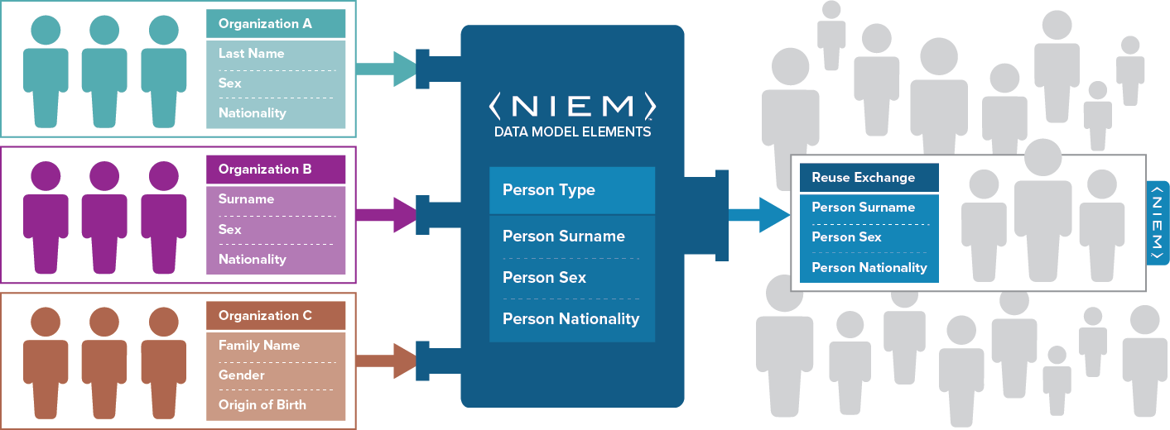
What is NIEM? – Exchanging Data and Components
Using NIEM, organizations come together to agree on a common vocabulary
When additional organizations are added to the information exchange, the initial NIEM exchange can be reused, saving time and money

Slide 13
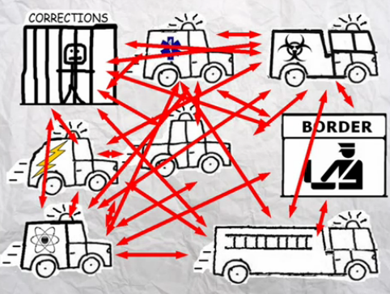
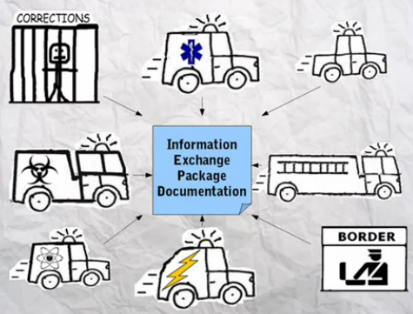
What is NIEM? – Simplified Exchanges
When using NIEM, you only need to “speak” two languages: your own and NIEM
Without NIEM
With NIEM

Slide 14
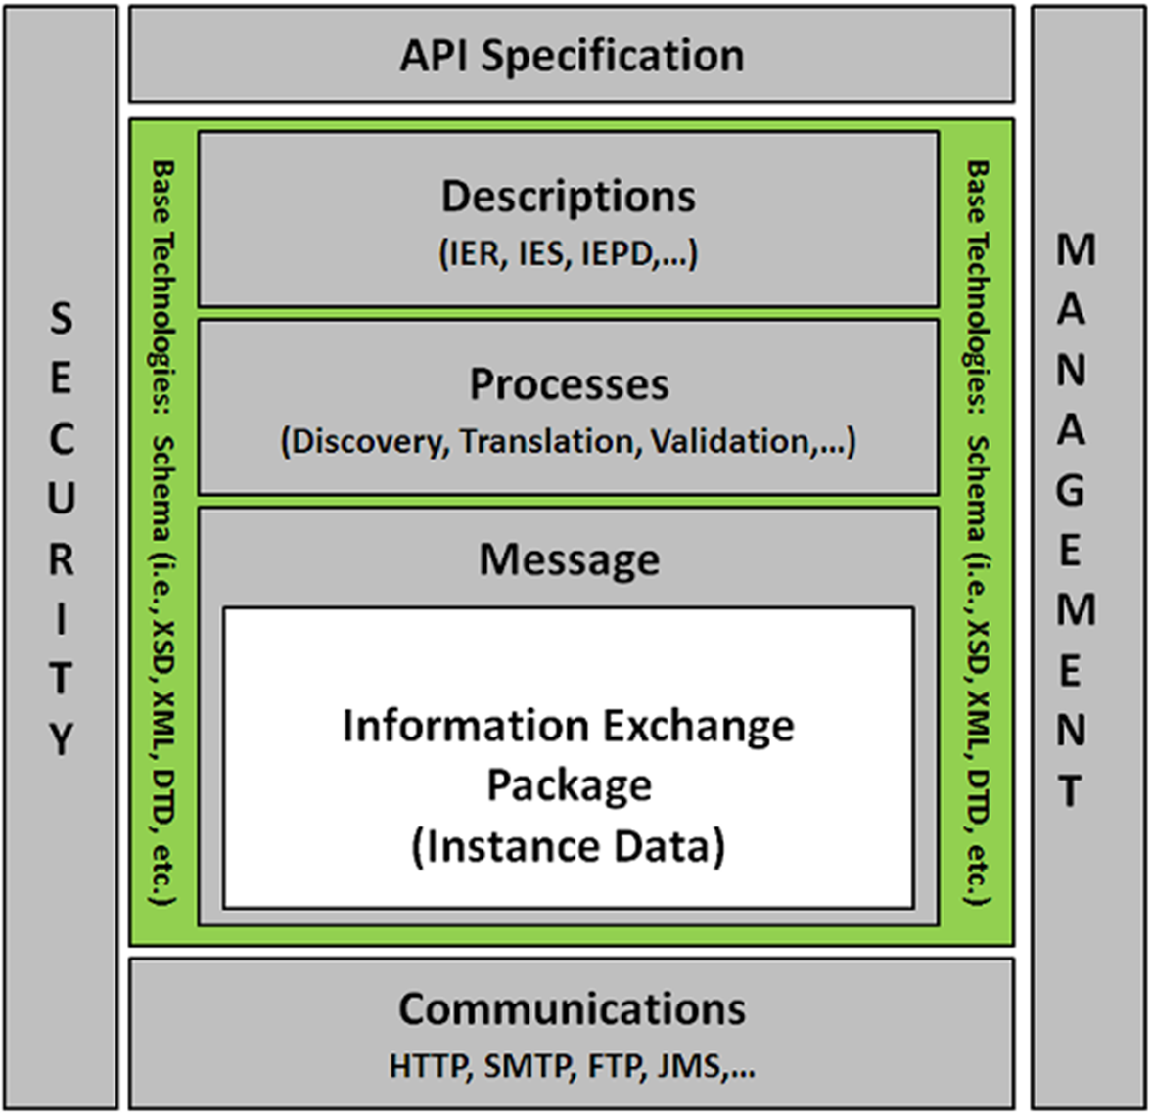
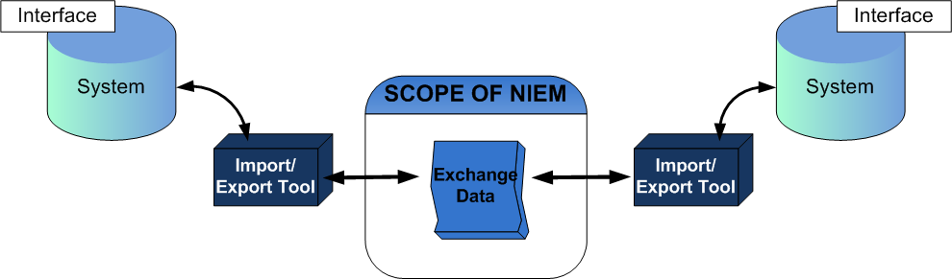
Scope of NIEM
NIEM is a data layer standard and intentionally does not address all the necessary technologies needed for information sharing
Exchange partners decide how to store and process the NIEM-conformant data being exchanged

Slide 15
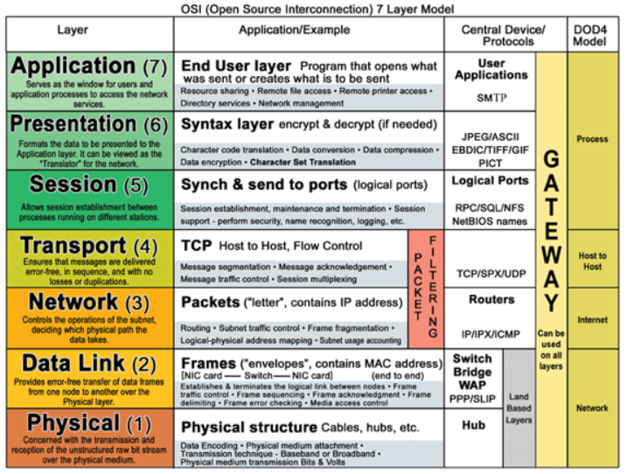
Open Source Interconnection (OSI) model

Slide 16
Open Source Interconnection (OSI) model

Slide 17
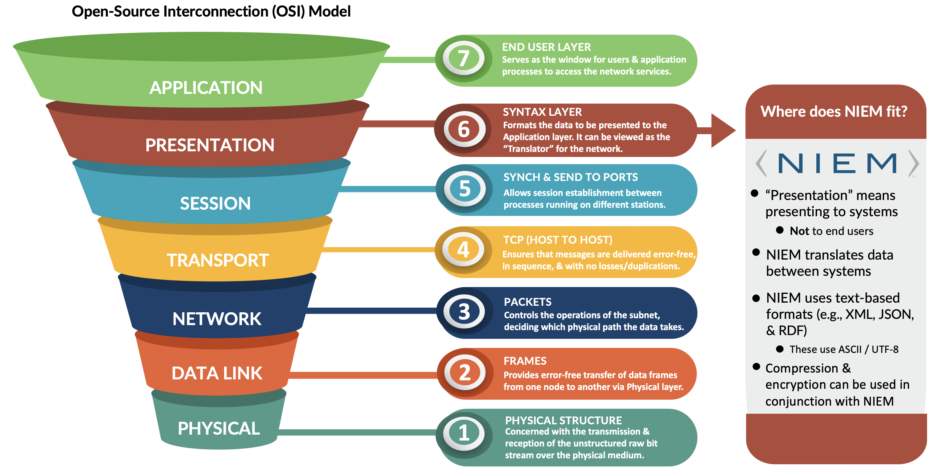
Open Source Interconnection (OSI) model

Slide 18
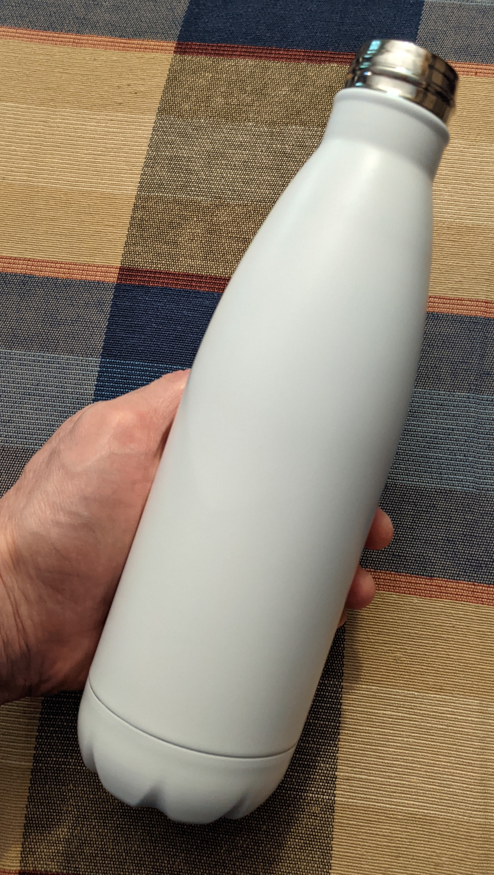
Bottle of Liquid
A bottle of liquid:
Has a shape
Made of certain materials
Can be opaque or transparent
Has some combination of liquids inside
Is moved around by various means

Slide 19

Bottle of Liquid
NIEM is the liquid inside, the payload document
NIEM doesn’t care about how you filled the bottle, how the bottle is constructed, how the bottle is transported, whether you can see into the bottle, and what you do with the liquid after you pour it out

Slide 20
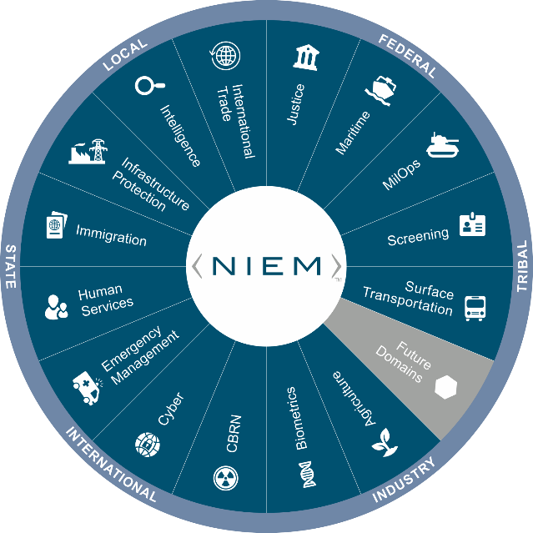

NIEM Harmonization and Organization
Common Language (Data Model Lifecycle)
Repeatable, Reusable Process
(Exchange Specification Lifecycle)
Built and governed by users within the Federal, State, Local, Tribal, and Private Sectors

Slide 21
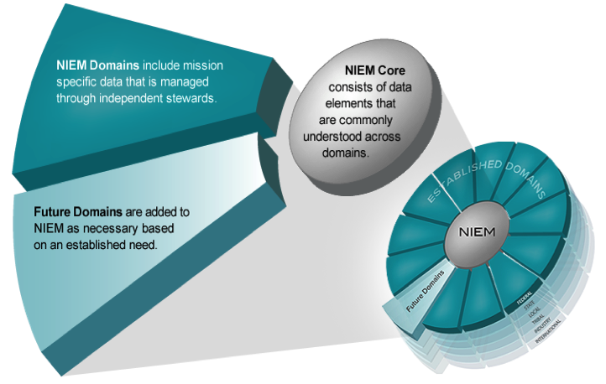

NIEM Harmonization and Organization
Think of the NIEM data model as a mature and stable data dictionary of agreed-upon terms, definitions, relationships and formats independent of how information is stored in individual agency systems
The data model consists of two sets of closely related vocabularies:
NIEM core
Individual NIEM domains
NIEM core includes data elements commonly agreed upon across all NIEM domains (i.e., person, activity, location, and item, etc.)
Individual NIEM domains contain mission-specific data components that build upon NIEM core concepts

Slide 22
NIEM Harmonization and Organization
Existing Domains
Agriculture
Biometrics
Chemical, Biological, Radiological, & Nuclear
Cyber
Emergency Management
Human Services
Immigration
Infrastructure Protection
Intelligence
International Trade
Justice
Maritime
Military Operations
Screening
Surface Transportation
Upcoming Domains:
Learning and Development
International Human Services

Slide 23
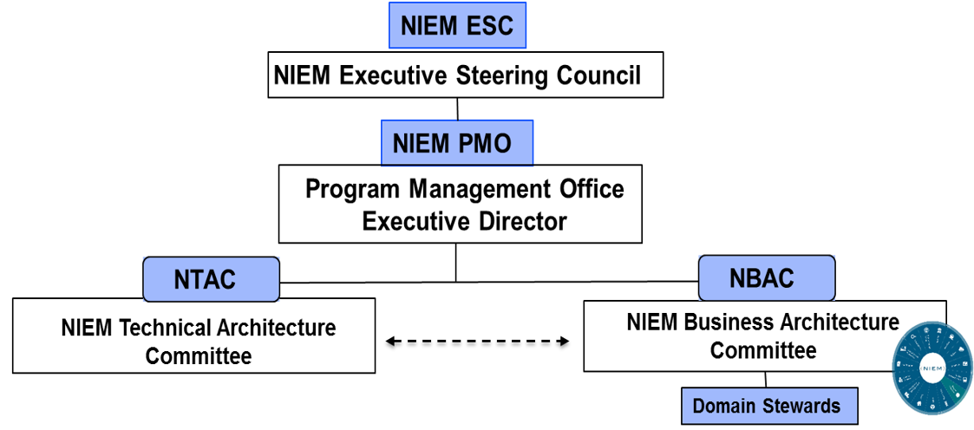
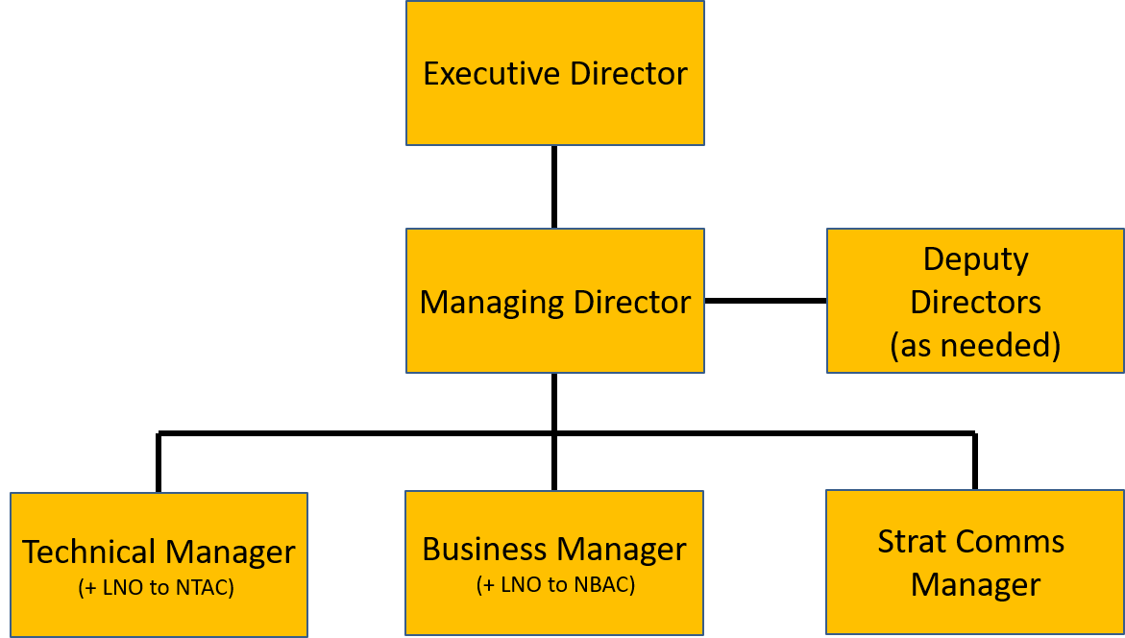
NIEM Harmonization and Organization
Chaired by DOD CDO SES Mr. Spirk
Quarterly or every 6 months
DOD CIO
JS J6
Led by JS J6 SES Mr. Whitehead
Conducts day-to-day management
JS6 provides NTAC and NBAC LNO
Oversees face-to-face stakeholder sessions
Internal NIEM MO structure manned by JS6 personnel
2 co-chairs + 12 selected Subject Matter Experts from across Gov’t and industry
- Focuses on technical specifications
Implementing NBAC business requirements
2 co-chairs + 40 members in 14 functional domains from across Federal / State / Local / Tribal / Territorial Gov’t plus international
- Focuses on model content

Slide 24
IEPD Development
Overview
Process
Artifacts

Slide 25
IEPD Overview
“Information Exchange Package Documentation”
Slowly changing to “Message Specification”
Defines an exchange
Made up of a bunch of documents, “artifacts”
Some meant for humans
Some meant for computers

Slide 26
IEPD Process
Scenario Planning
Requirements Analysis
Mapping
Assembly
Publishing
(Implementation)

Slide 27
IEPD Process
Code
UML Diagrams
Textual Documents
Mapping Spreadsheet
Schemas and Instance Documents

Slide 28
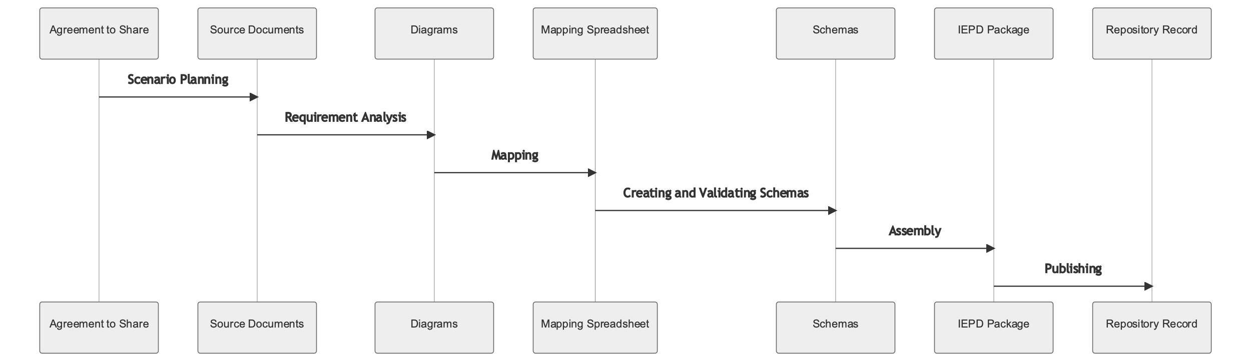
IEPD Process - Idealized

Slide 29
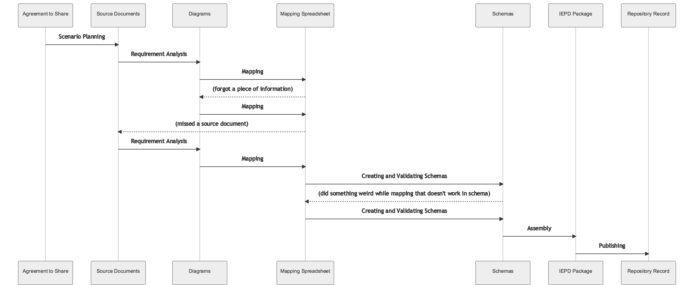
IEPD Process – Real Life

Slide 30
IEPD Artifacts - Documentation
Master Documentation (Word)
IEPD catalog document (iepd-catalog.xml)
Change log (text)
README (text)
Conformance assertion (text)

Slide 31
IEPD Artifacts - Definitional
Wantlist (wantlist.xml)
Schema subset schemas
Extension schemas
Exchange schemas
Sample instances
XML catalogs

Slide 32
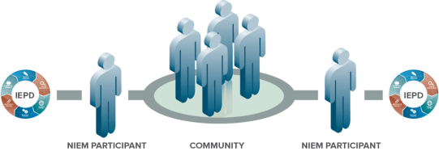
Scenario Planning
Decide what the exchange is about
Who are the exchange partners?
Who are stakeholders?
Communication is key
Existing exchanges or other documentation can help
Within your organization
From NIEM repositories (huge caveat)

Slide 33
Scenario Planning – Existing Documentation
Current technical architecture documents of all exchange partners
Stakeholders that will be involved in the exchange
Security, privacy, and other policy-related concerns associated with the exchange
Technical characteristics of the exchange:
Types of data being shared
Number of data objects
Current structure of the data (logical, physical)
Use of external standards

Slide 34
Requirements Analysis
Diagrams
Use Case Diagrams
Business Process Diagrams
Sequence Diagrams
Class Diagrams
Spreadsheets
Other documents

Slide 35
Potential Diagrams
Actor 1
Traveler Processing System
Use Case Diagrams
Review
Result
Leave Customs Station
Review
Documents
Submit
Documents
Use Case
Review Query Results
Traveler
Display Query Results
Airport Officer
Permission,
Granted
or
Denied!
Submit Query
Make Travel
Decision
Actor 2
Display
Result
Start Person
Query Message
Process Query Message
Return Query Results
Airport Screening Application
Create Traveler History Message
Send Traveler
History Message
Save Traveler History
Customs
Application

Slide 36
Potential Diagrams
Business Process Diagrams
Business Process Diagram Example
Traveler
Submit Documents
Leave Customs Screening Station
Start
Yes
Airport
Officer
Review & Submit Query
Review Person Query Results
No
Perform Investigation
Release traveler?
Stop
Airport Screening
Application
Execute Person Query Message
Display Person Query Results
Create & Send Person History Travel Message
Customs Application
Process Person Query Message
Return Person Query Results
Save Traveler HIstory

Slide 37
Potential Diagrams
Sequence Diagrams
Airport Screening Application
Customs
Application
Airport History Application
sendPersonQuery(person)
returnPersonResults(person)
sendPersonHistoryTravelQuery(person)
returnPersonHistoryTravelResults(person, history)

Slide 38
UML Class Diagrams
The bread and butter of IEPD business requirements
Can be oriented towards business terms and objects
Better for consensus
Can be oriented towards NIEM terms and objects
Pre-loads the mapping step

Slide 39
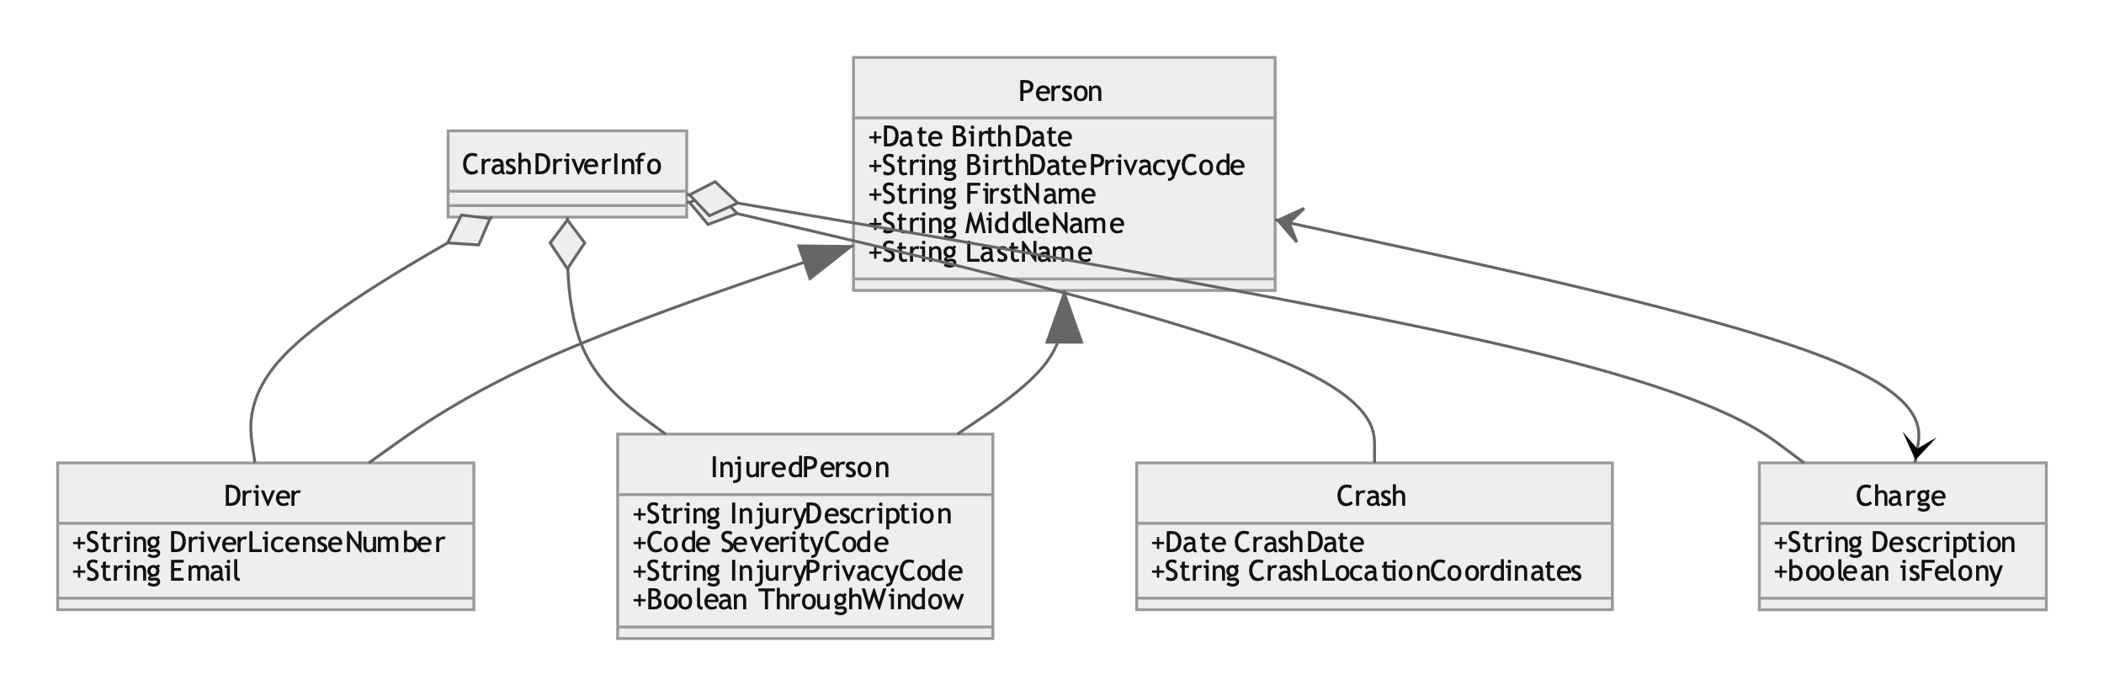
Business Oriented Class Diagram

Slide 40
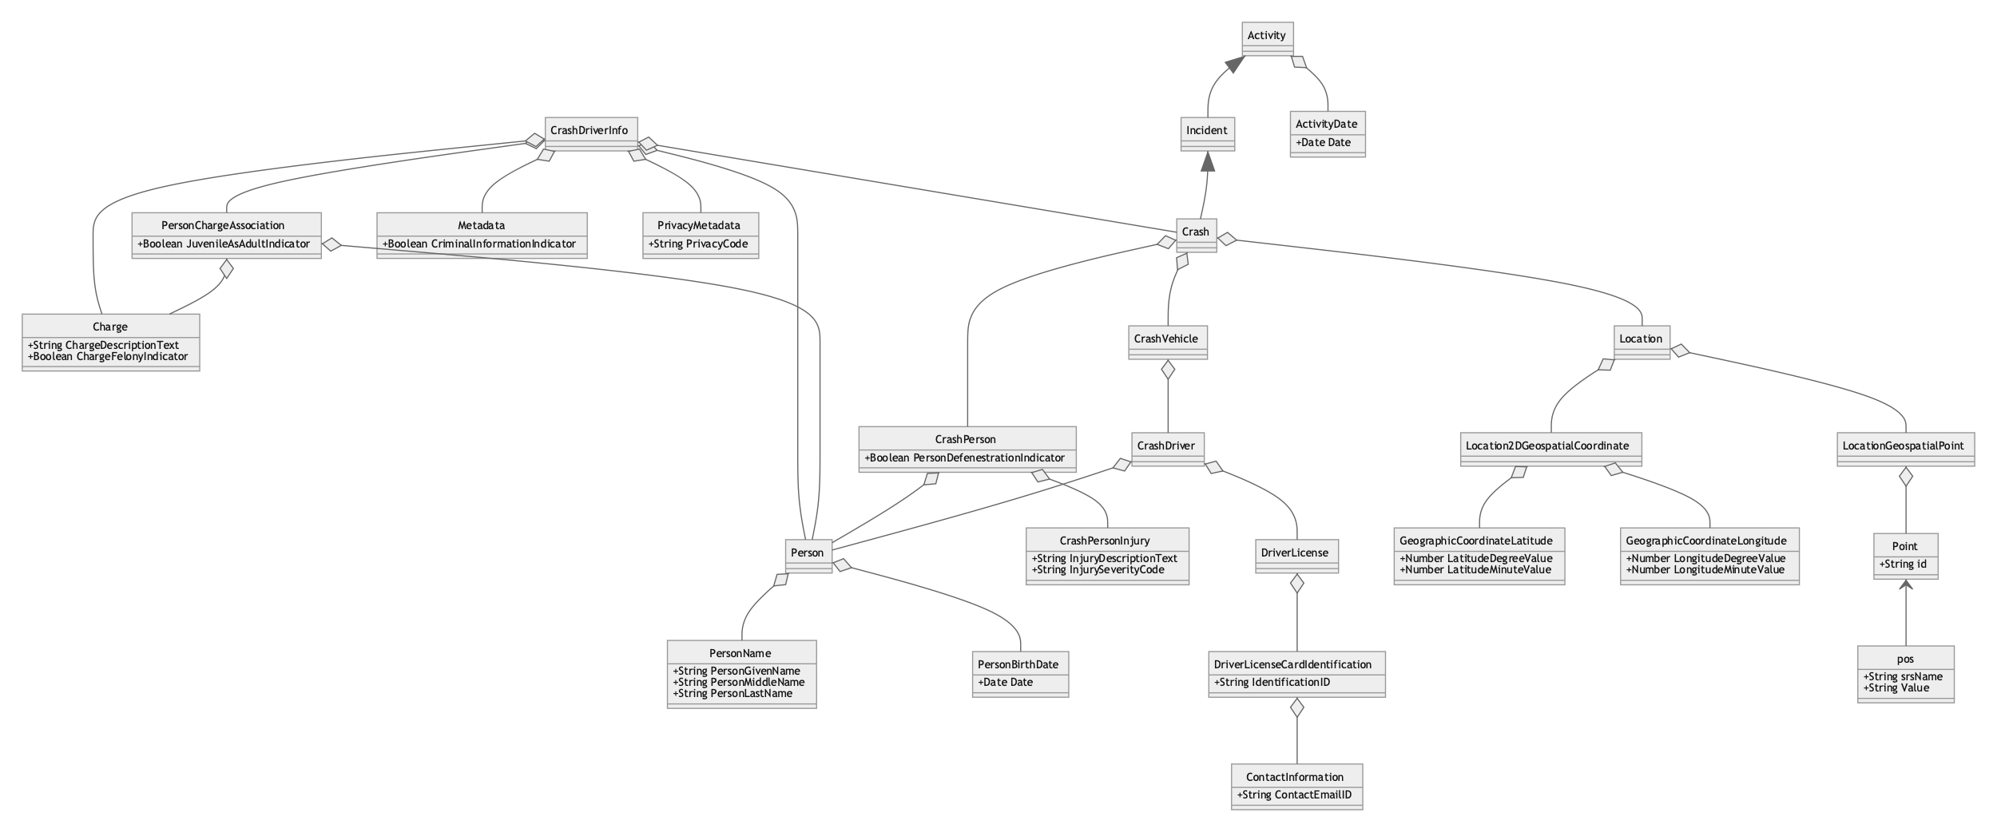
NIEM Oriented Class Diagram

Slide 41
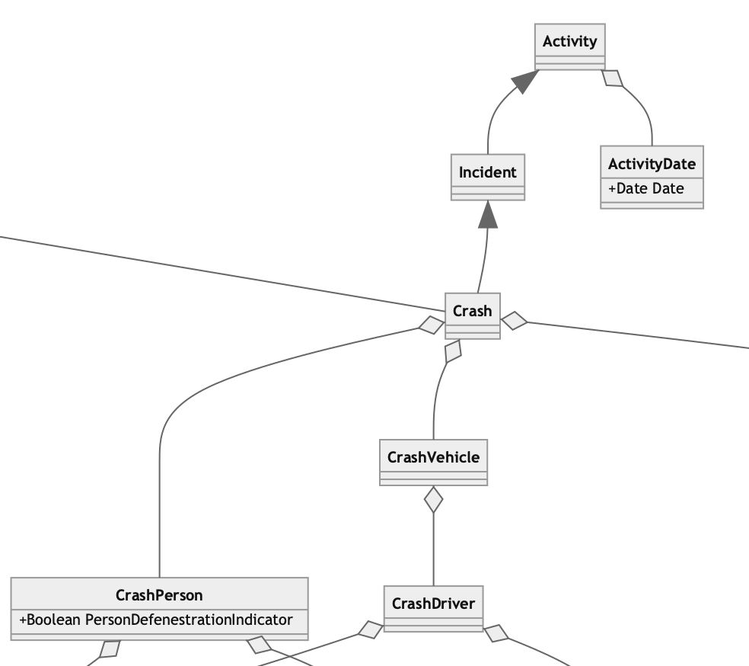
NIEM Oriented Class Diagram

Slide 42
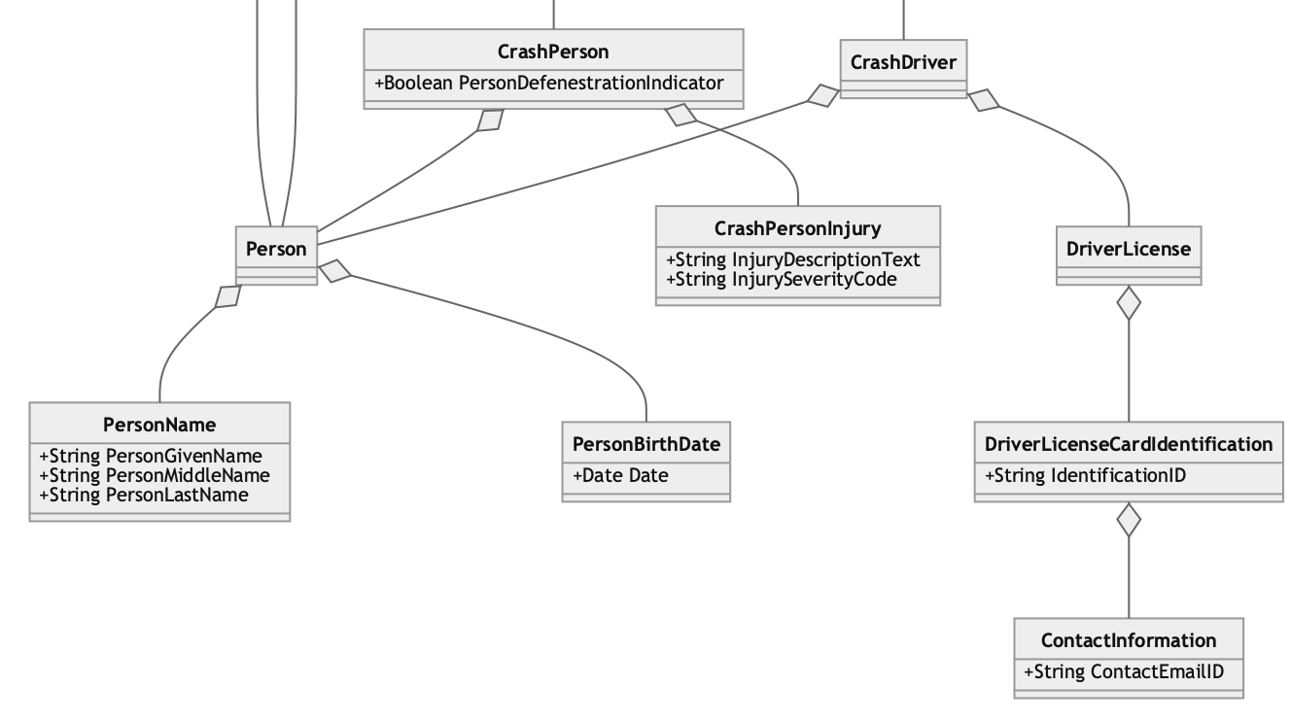
NIEM Oriented Class Diagram

Slide 43
UML Tools
ArgoUML
BOUML
MagicDraw / Rational Rose ($$$)
Visio / OmniGraffle
Mermaid / Graphviz
Many more…

Slide 44
Business Rules
Some rules aren’t easily represented in UML
You can use whatever works for your needs
Schematron for XML
Plain old textual descriptions are great!

Slide 45
The Process from Here On…
Step-by-step
Finish mapping entirely before starting schemas
Concurrent
Building schemas and instances as you go
We'll use something in-between
Build an ersatz matching instance document as we map
Save schemas for the end
(use a super secret tool to help)

Slide 46
Introduction to Mapping
Mapping Spreadsheets Options
NIEM Mapping Template
Simple Training Spreadsheet
Something In-between
Document Business Objects
Map them to NIEM objects, existing or new
Maintaining an Ongoing Sample Instance Skeleton

Slide 47
NIEM Mapping Template
Primarily for submitting content for inclusion in NIEM
Eight different tabs
Can also be used for mapping in an IEPD
Just need one of the tabs
Is a bit overkill for an IEPD

Slide 48
Simple Training Spreadsheet
Minimal
Designed to be simple enough to fit on slides
No, really, that’s the constraint
Usually expanded in practice
Source Container Type
Source Element
Source Date Type
Source Element Definition
Mapping
NIEM Element
NIEM Element Path
NIEM Type
NIEM Element Definition
A
C
B
Source Data Columns
Mapping Column
NIEM Data Columns

Slide 49
Tom’s Custom Mapping Spreadsheet
Has evolved over time
Contains all the info needed to make schemas
Not as overwhelming as the NIEM Mapping Template
Works with in-progress secret tools
You can make your own custom one
The IEPD Spec doesn’t specify a required format, by design

Slide 50
Basics of Searching NIEM
Tools
SSGT
Wayfarer
NIEM Schemas
Spreadsheet

Slide 51
Basics of Searching NIEM
Methods
Search for Terms
Simple vs Advanced
Search for Synonyms
Search for Word Roots
Search for Containers
Search for Properties

Slide 52
Mapping to Existing NIEM Objects
XML Schema uses elements and types
What an element can hold is based on its type
What you are (your type) defines what you can hold

Slide 53
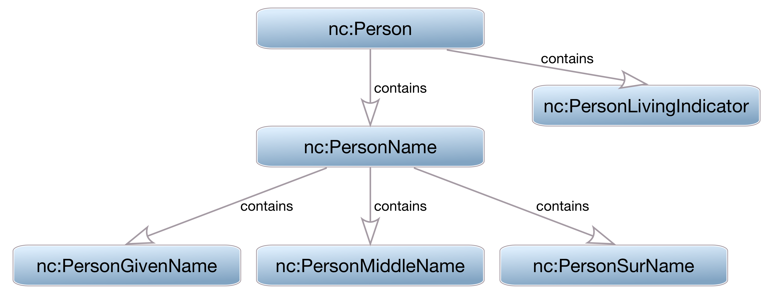
What you are defines what you hold

Slide 54
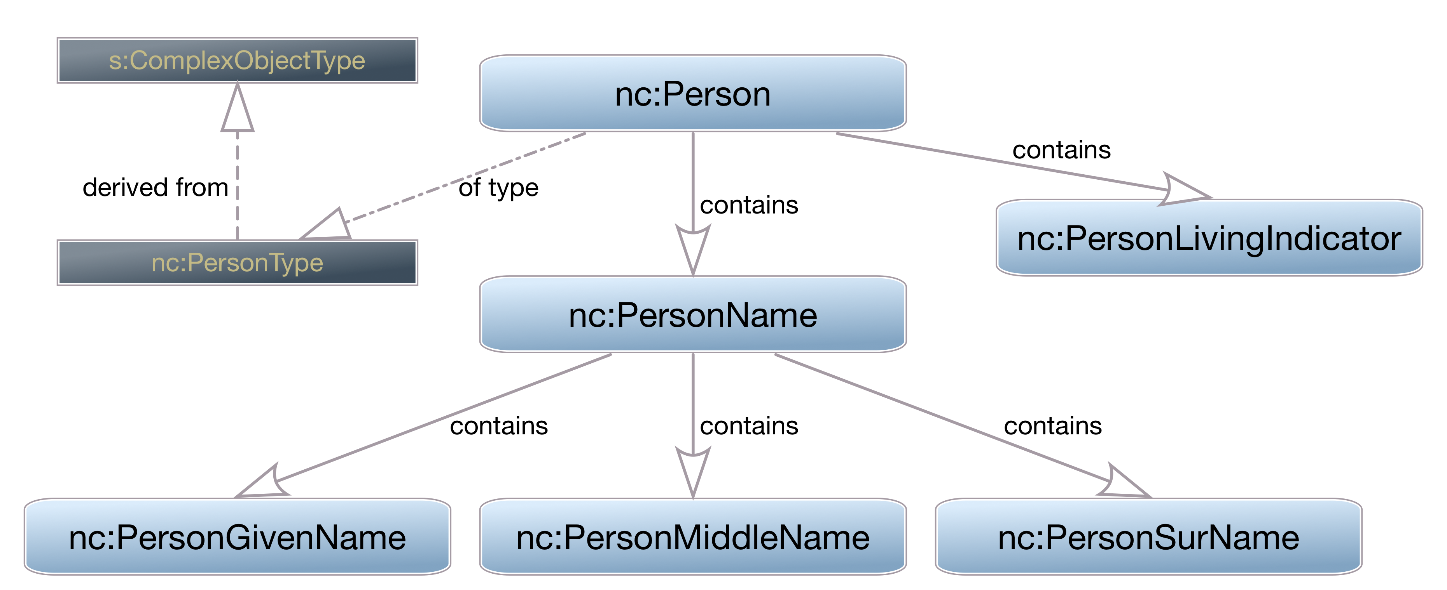
What you are defines what you hold

Slide 55
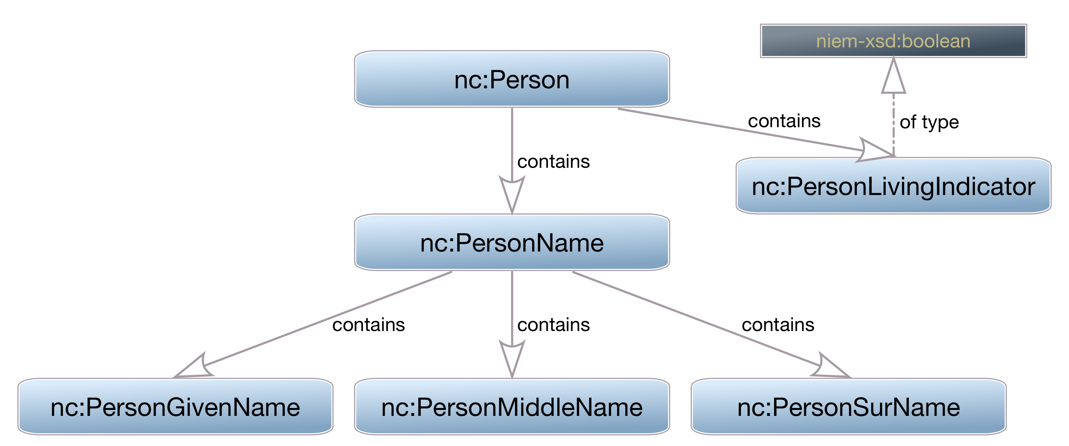
What you are defines what you hold

Slide 56
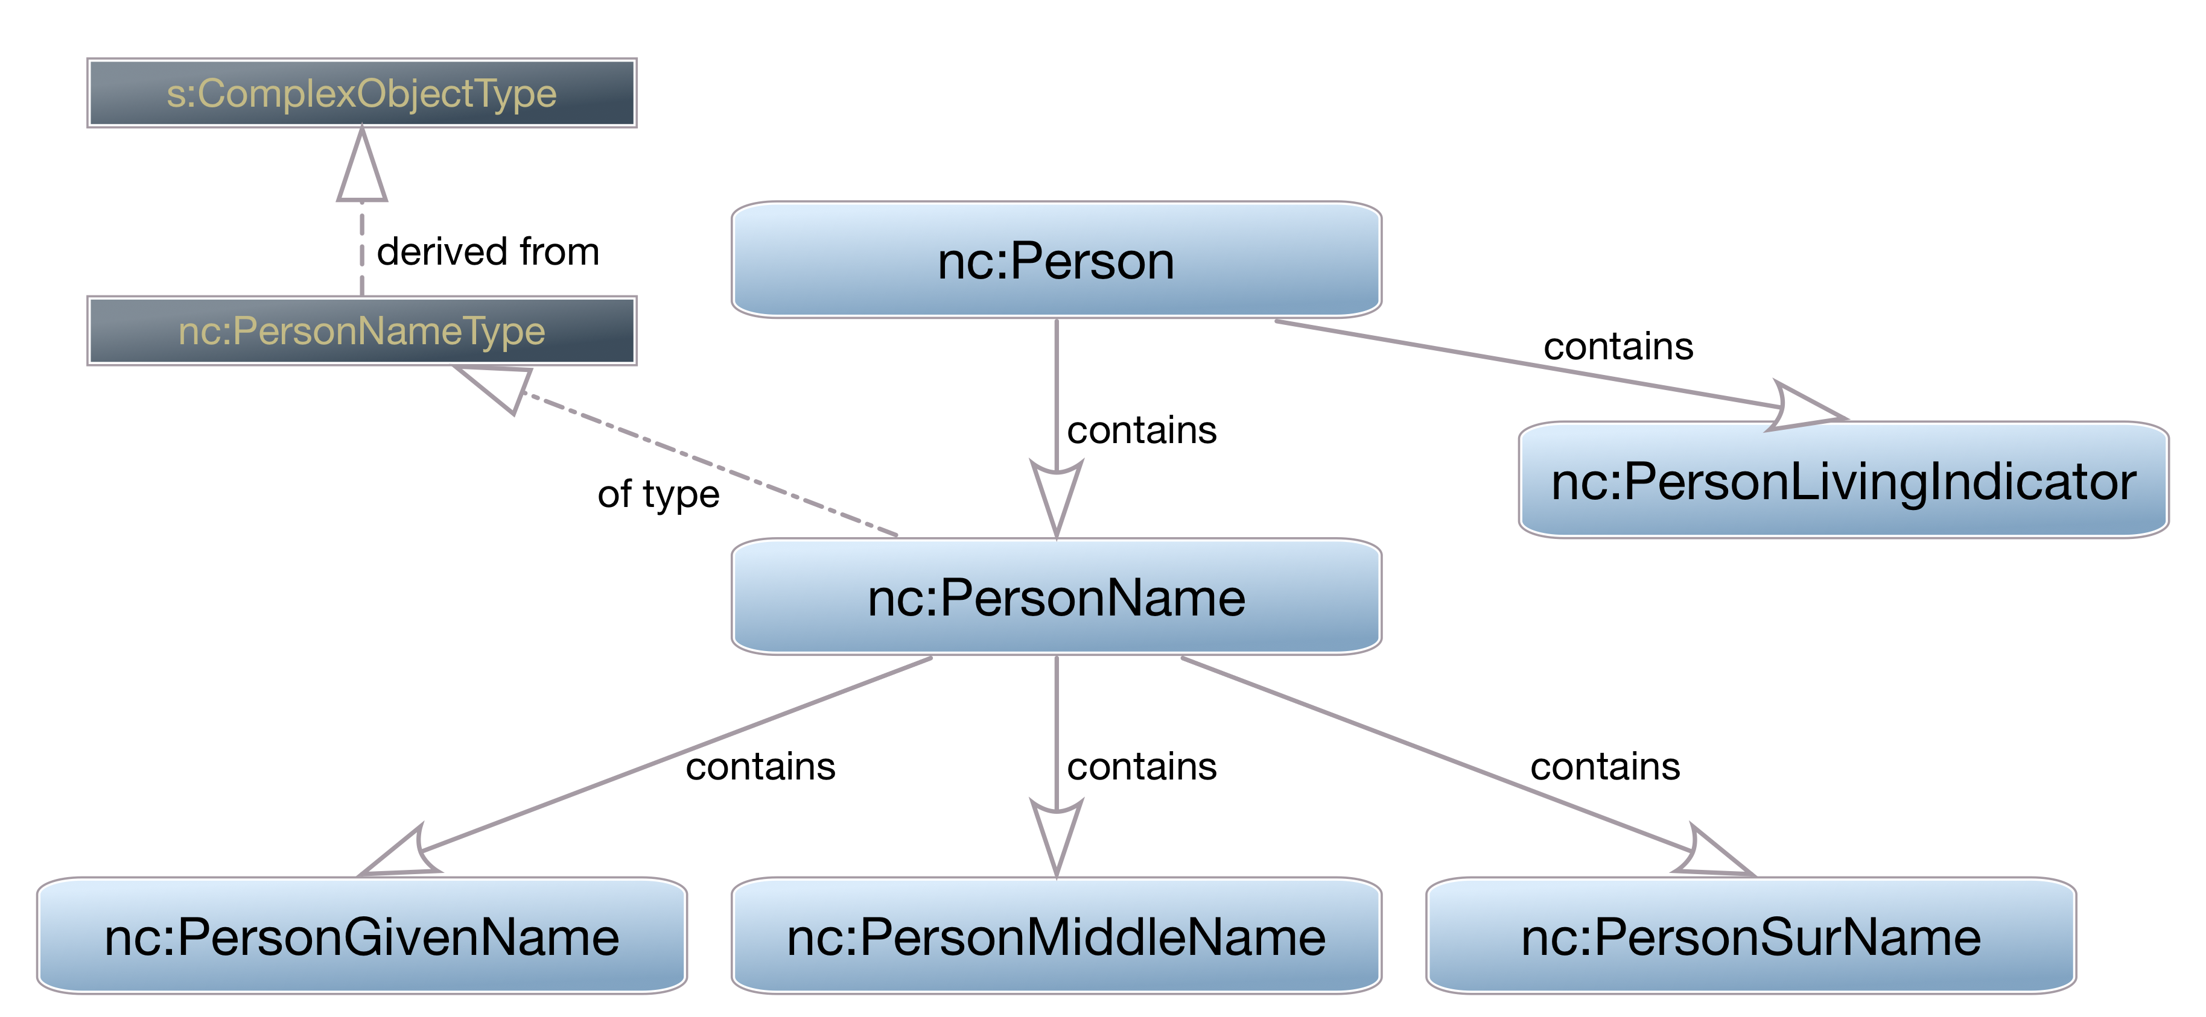
What you are defines what you hold

Slide 57
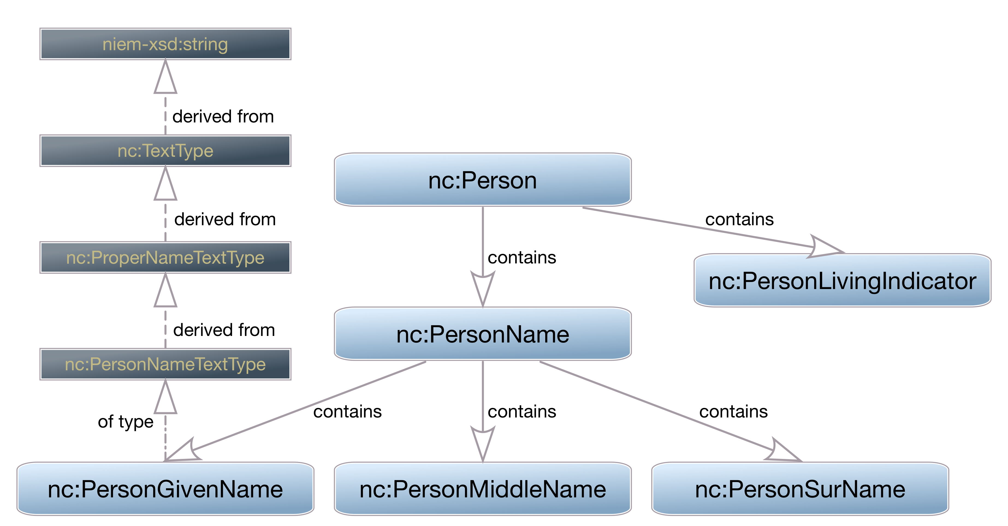
What you are defines what you hold

Slide 58
Native Properties
Some things will be easy to find
Will map directly to NIEM objects
Examples:
nc:Person, nc:PersonName, nc:PersonGivenName, etc.

Slide 59
Substitution Groups
Some concepts can be represented multiple ways
Text / code combinations are common
Date can be a date, datetime, or a range
NIEM uses substitution groups to support both:
The single concept, and
Multiple representations of that concept
Examples:
nc:PersonBirthDate
SomethingRepresentation or WhateverAbstract

Slide 60
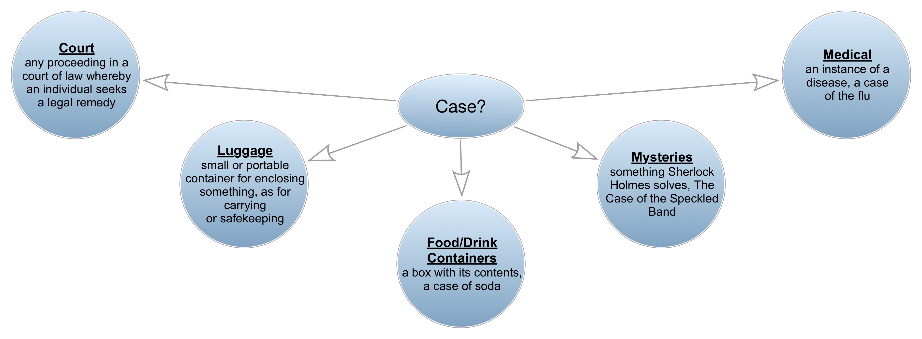
Namespaces
Namespaces organize elements by context
Identified by prefix, a nickname for the namespace
NIEM governance is organized along these lines

Slide 61
Inherited Properties
NIEM is a model, not a flat data dictionary
Some concepts don’t exist as elements using the terms for the concept
Instead, properties are inherited
There is no “Crash Date” in NIEM
There is an Activity Date which can be inside a Crash object
Deepest inheritance? j:CommercialVehicle

Slide 62
Code Tables
Codes help ensure accurate information
Codes are, essentially, strings, simple data
Elements in the domains
Types are often in their own namespaces
NIEM wraps them in a complex type in order to apply some attributes needed for infrastructure
Which we will need in the next section…
Example: j:InjurySeverityCode, anything ending in “Code”

Slide 63
Linking Things Together
NIEM is relational in many senses
Objects can refer to each other across an XML hierarchy
Allows NIEM to represent real world, many-to-many relationships
“structures” namespace provides the infrastructure

Slide 64
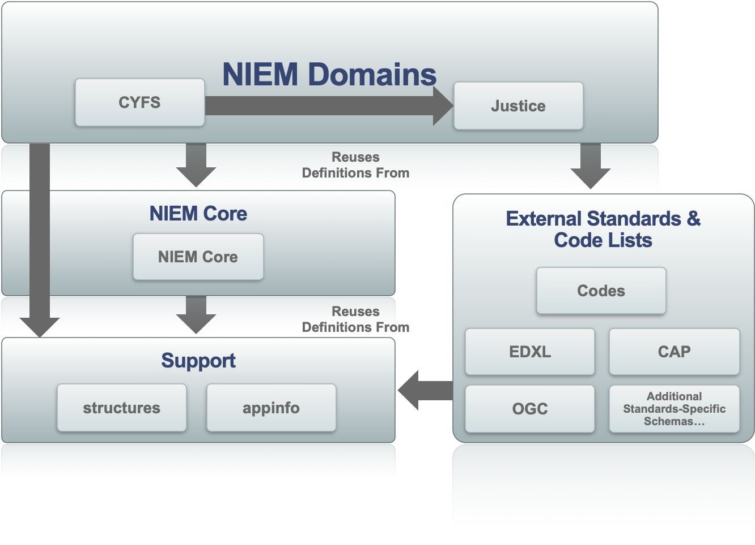
NIEM Structural “Layers”

Slide 65
Referencing
NIEM lets you assign unique IDs to object
Other objects can then link to those objects by referencing the ID
Everything in NIEM can have attributes for this:
id
ref
metadata
These leverage built-in XML Schema attributes ID, IDREF, and IDREFS

Slide 66
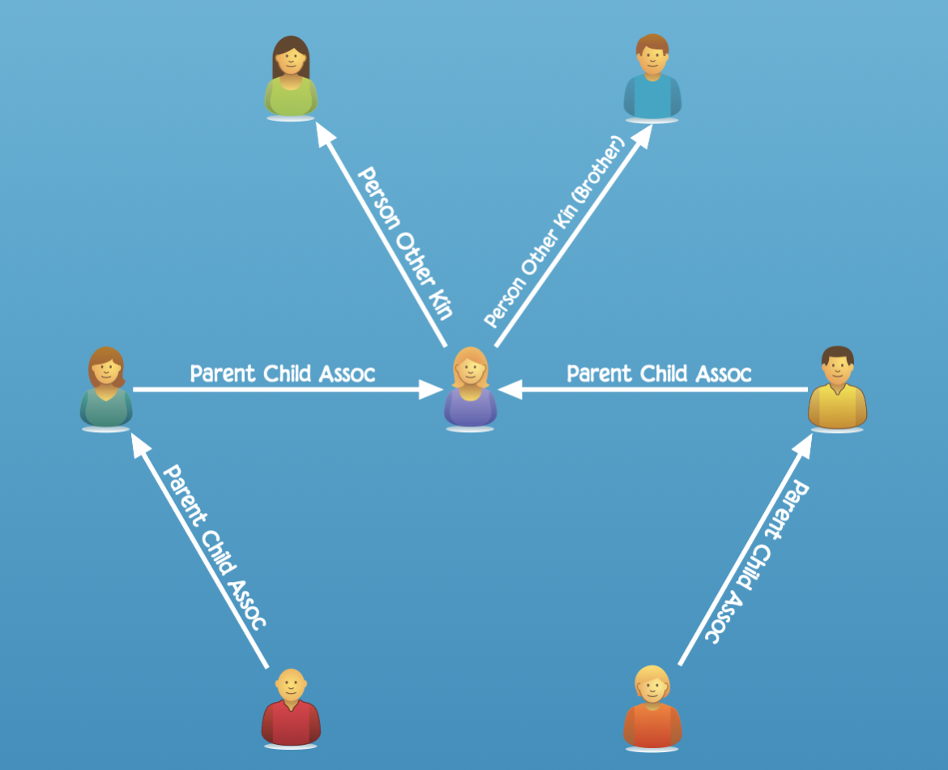
Associations
Relationships can be complex
NIEM provides powerful Association objects
Tradeoff can be implementation complexity

Slide 67
Associations
Associations link objects together
Associations reference the associated objects
Can link to multiple objects
Can thus form many-to-many relationships between them
Associations also hold information about the association itself
Date or Date Range is a common example
Associations can also just include them, if applicable
Example: j:PersonChargeAssociation, anything ending in “Association”

Slide 68
Roles
Modeling some objects as specialized things gets complicated
Roles are, well, roles that objects play
People, organizations, items are the major ones
Roles reference the objects playing the role
Objects can thus play multiple roles
Roles can also just include the object playing the role
Roles contain other information about the role
Example: j:CrashPerson, anything containing an nc:RoleOfPerson, Org, or Item

Slide 69

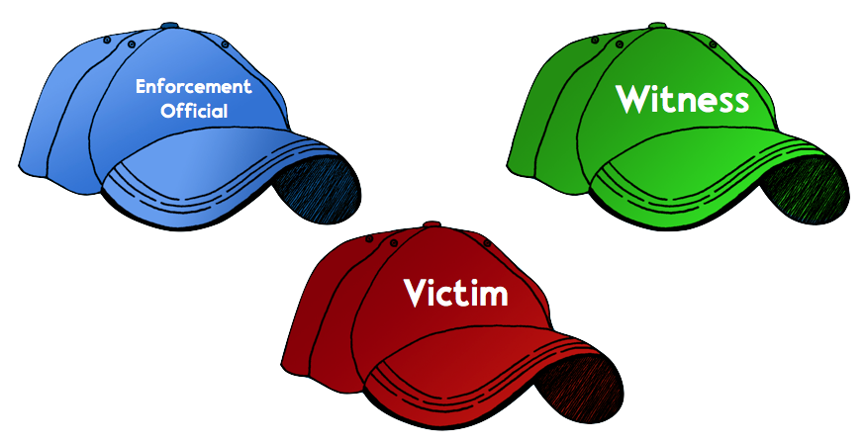
Roles – Not Special Kinds of People
This is just a guy.

Slide 70

Roles – Allows an Object to Play Multiple Roles

Slide 71
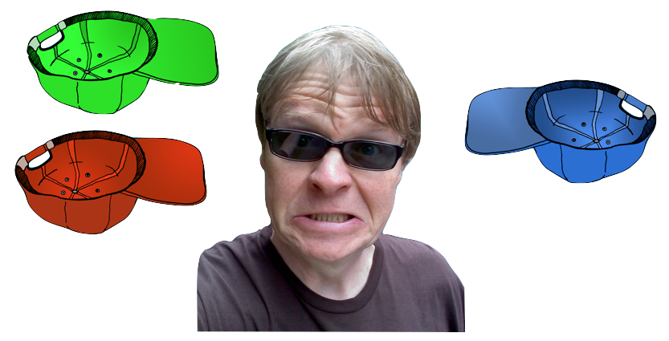
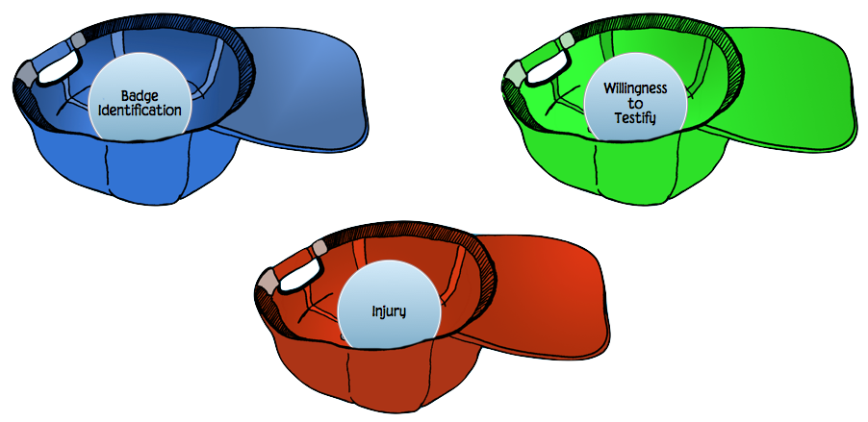
Roles
Roles Contain Info About the Role
Roles Point to the Object Playing the Role

Slide 72
Metadata
Metadata is data about data
Objects reference the metadata objects that apply to them
An objects can reference more than one metadata object
More than one object can reference the same metadata object
Example: j:Metadata (w/ j:CriminalInformationIndicator)

Slide 73

Data Metadata
Reporting Organization: Godspeed Animal Care
Reporting Person: Dr. Shiller
Reported Date: 2019-12-13
Last Verified Date: 2021-06-10
Name: Jett
Sex: Female
Weight: 8 pounds

Slide 74
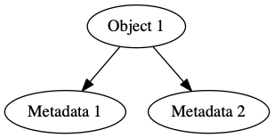
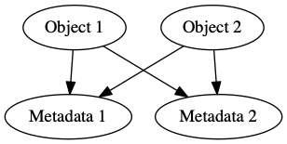
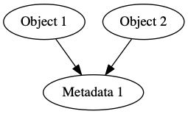
Metadata
Easy to apply same metadata to many objects
Easy to apply multiple metadata objects to one object
Can result in messy many-to-many relationships
Powerful, but can be difficult to implement

Slide 75
Combining Domains
Sometimes you just want to add properties from other domains to an object without making a special kind of thing
Augmentations are bags of stuff
Augmentation Points are hooks onto which to hang the bags of stuff
Augmentations are an easy way to extend objects to meet your exchange needs
Example: j:DriverLicense, j:DriverLicenseAugmentationPoint, and exch:LicenseAugmentation

Slide 76
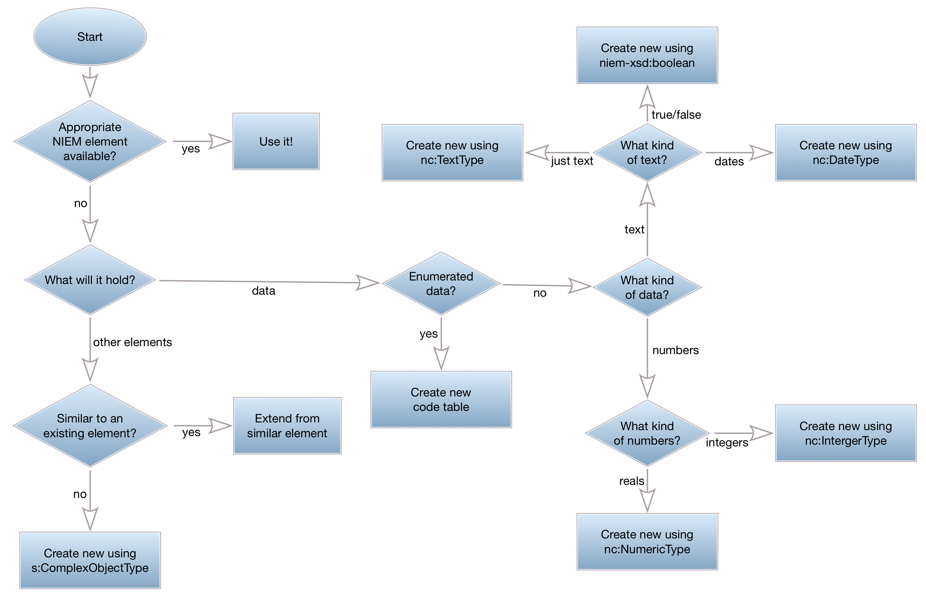
Creating New Objects

Slide 77
Creating Simple Data Elements
Base them on whichever XML Schema type is appropriate
Follow the flowchart for help
Base on the niem-xs adapters if you need referencing
Folks generally do this anyway, for consistency
Follow the format of existing NIEM elements of that type, especially regarding the last term, e.g. “Text”, “Code”, etc.

Slide 78
Creating Complex Objects
If you’re making a special kind of existing NIEM type:
Use that type as a base to extend from and add things to it, or
Create an Augmentation to hold your new things
If you’re starting from scratch:
Use structures:ObjectType as a base to extend from and add things to it

Slide 79
External Standards
NIEM supports external standards, if they’re XML
Wraps them in NIEM-conformant adapters
Example:
NIEM: nc:LocationGeospatialCoordinateAbstract
NIEM-conformant adapter: geo:LocationGeospatialPoint
External standard: gml:Point
You’ll probably never use this, but should know it’s there
SSGT supports them; Wayfarer doesn’t

Slide 80
Creating and Validating Schemas
Conformance
How things fit together
Subsets
Extension and Exchange Schemas

Slide 81
NIEM Conformance
Follow the rules in the Naming and Design Rules (NDR)
Follow the rules in the IEPD Spec
Many NDR rules exist as Schematron
Can check these via the Conformance Testing Assistant (ConTesA)
Can run the Schematron directly in an XML editor

Slide 82
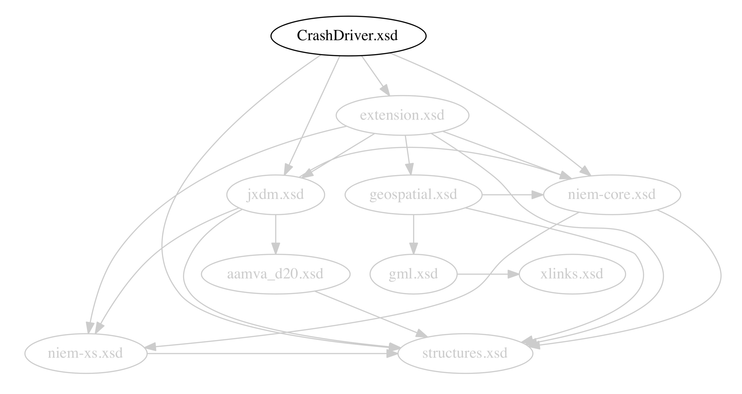
How Schemas Fit Together
Exchange Schema

Slide 83
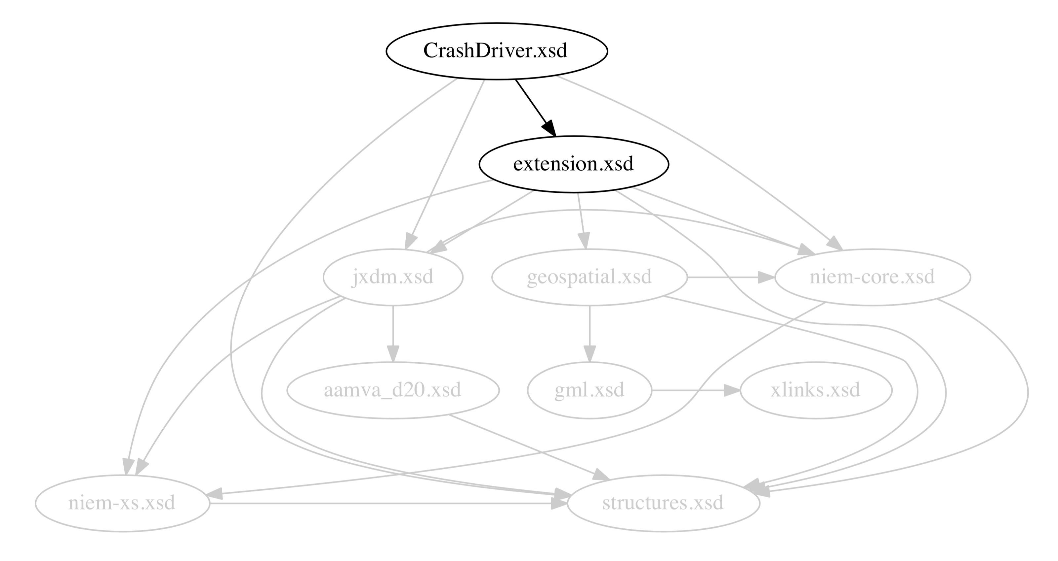
How Schemas Fit Together
Extension Schema

Slide 84
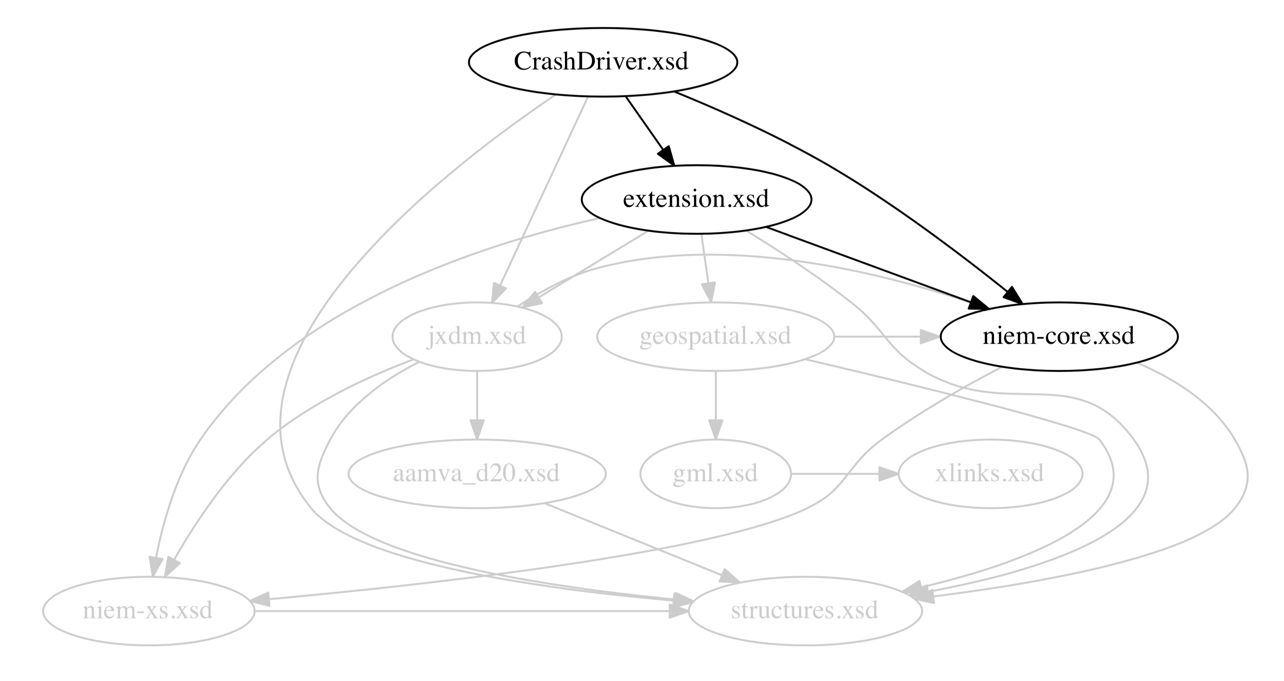
How Schemas Fit Together
NIEM Core

Slide 85
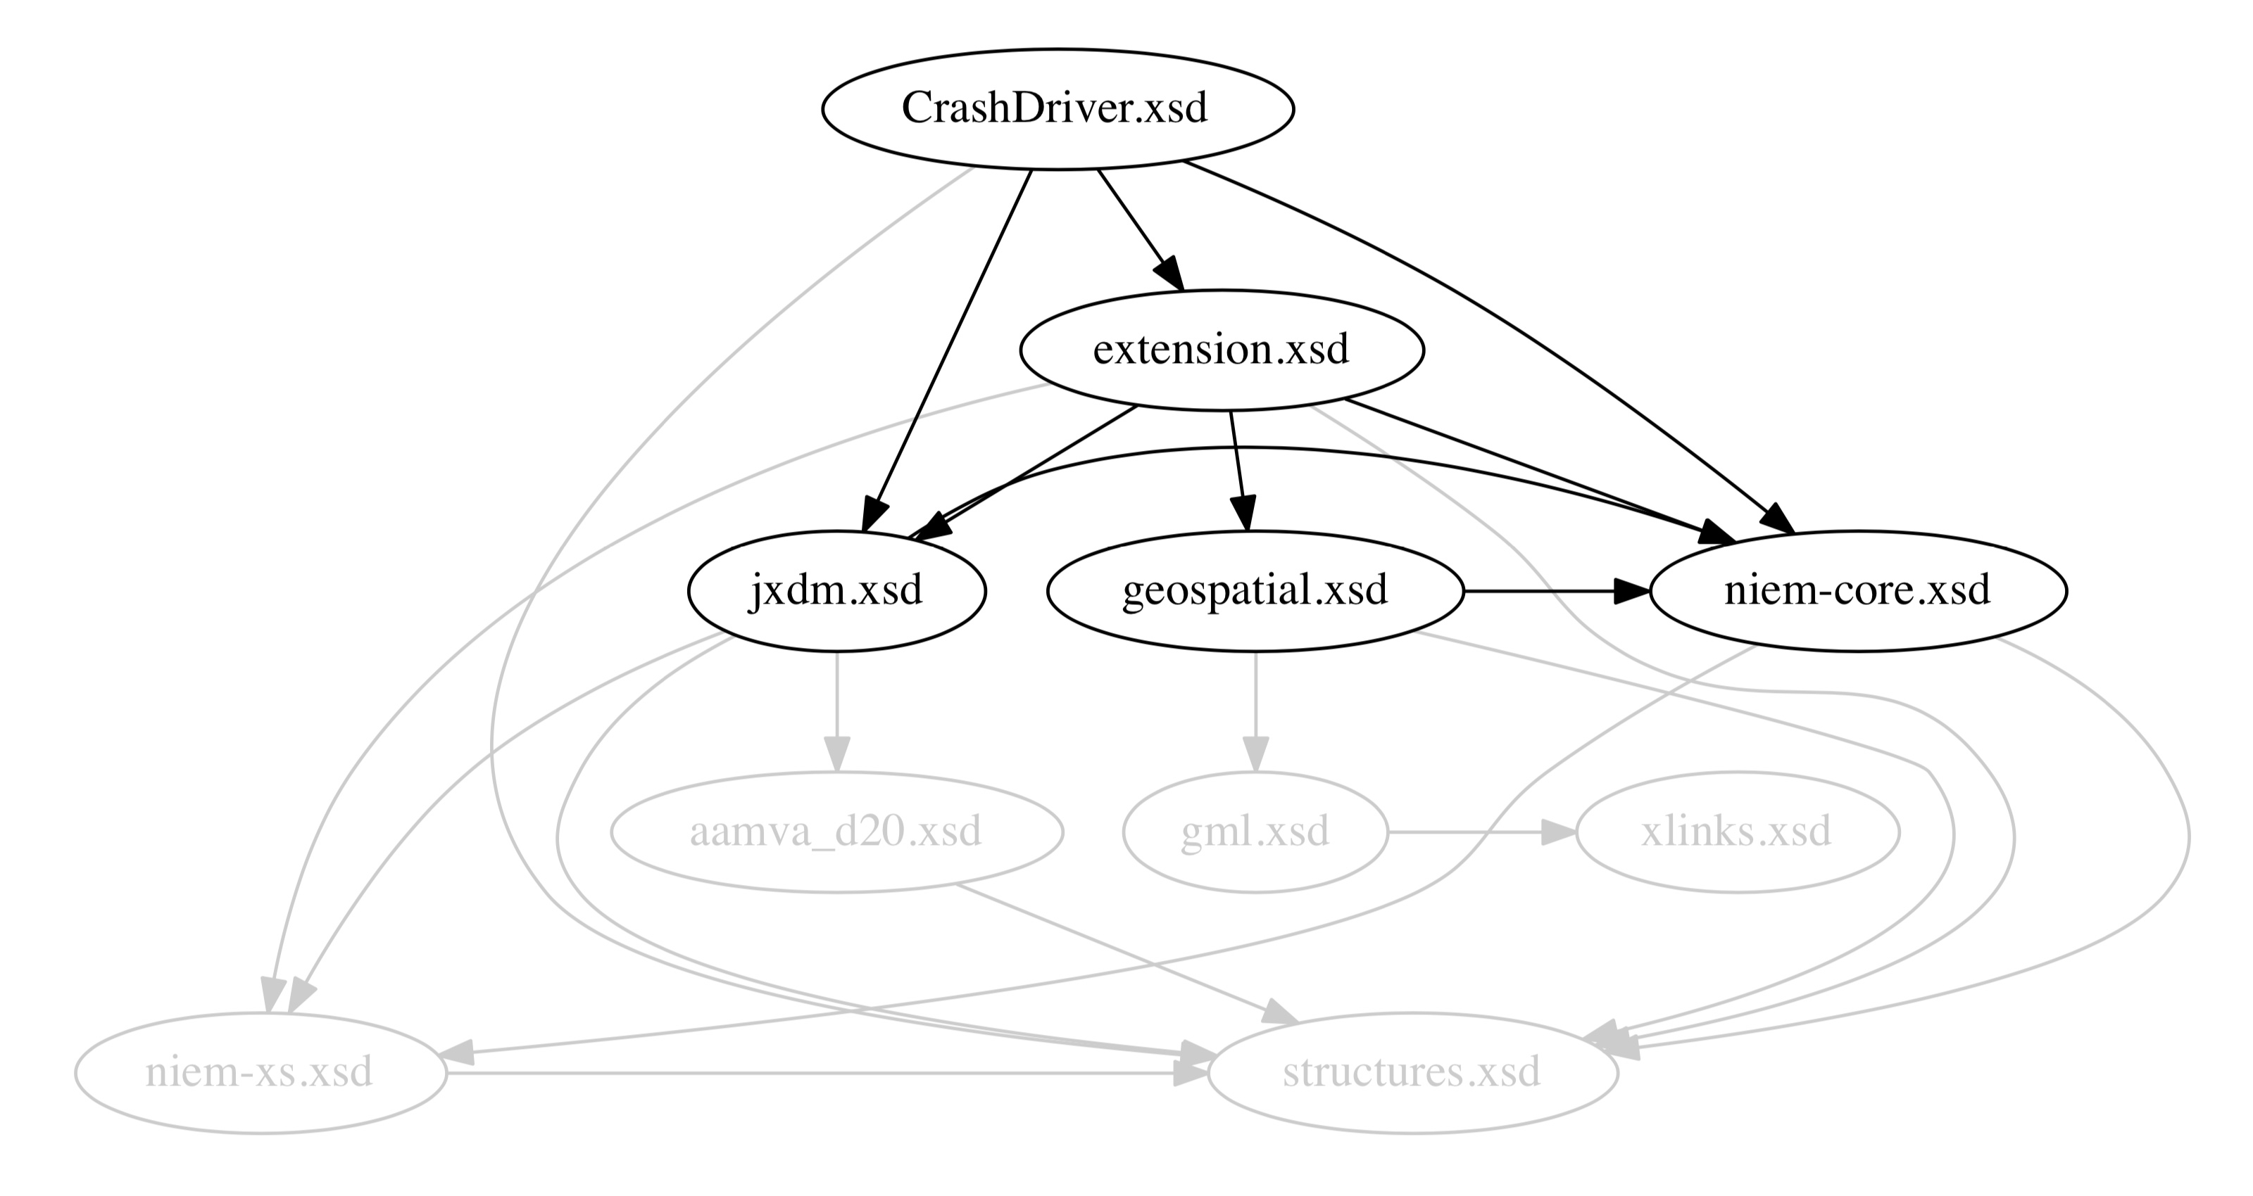
How Schemas Fit Together
Domains

Slide 86
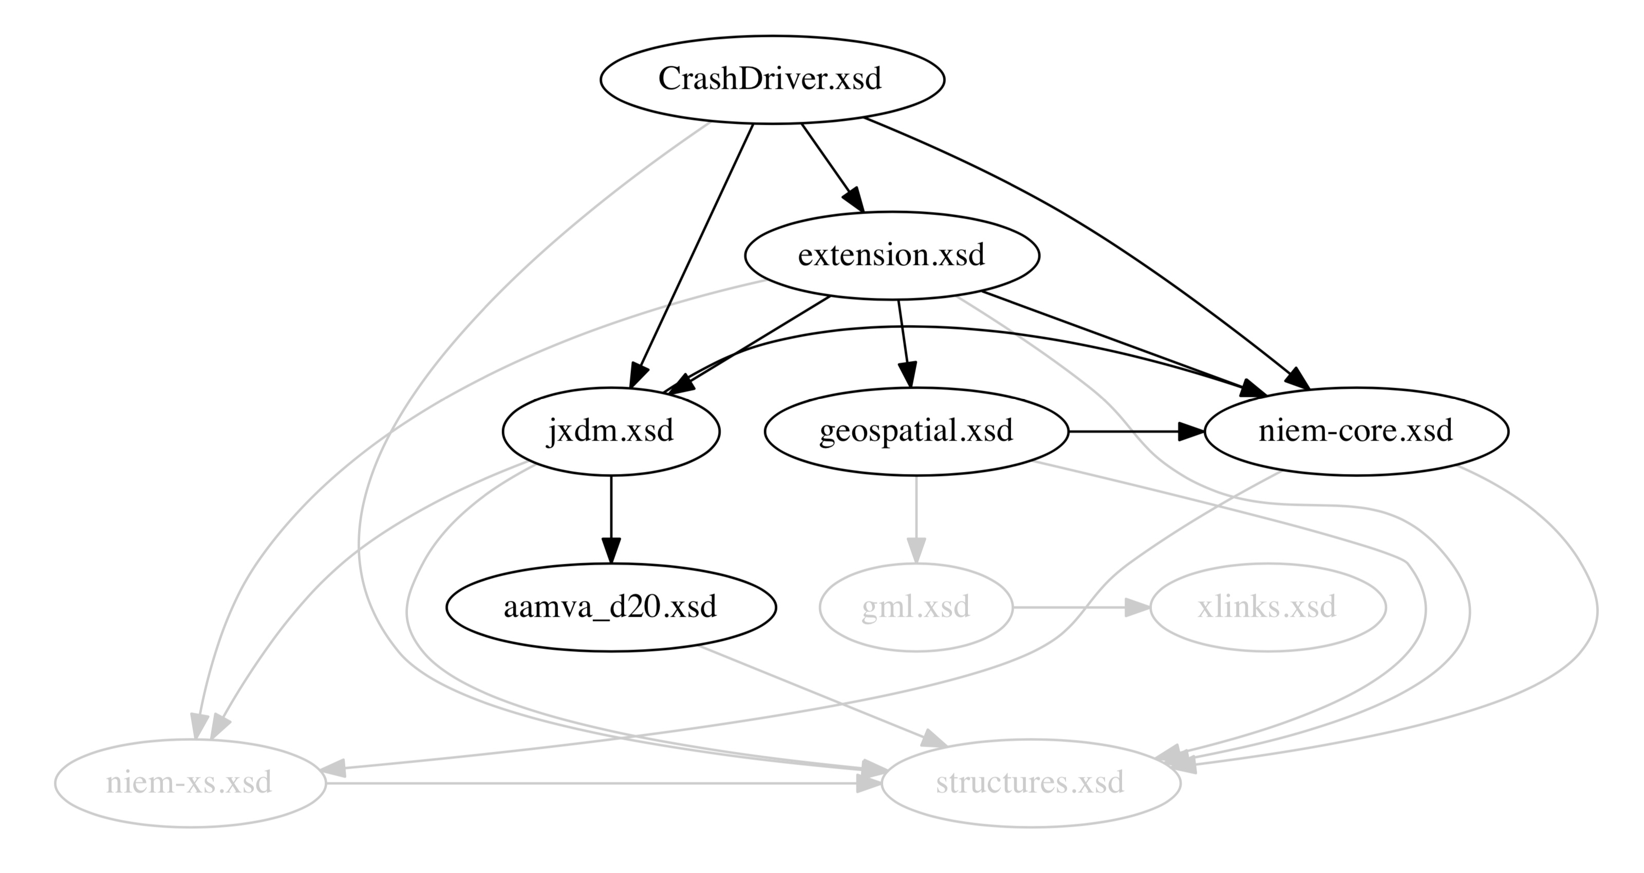
How Schemas Fit Together
Code Tables

Slide 87
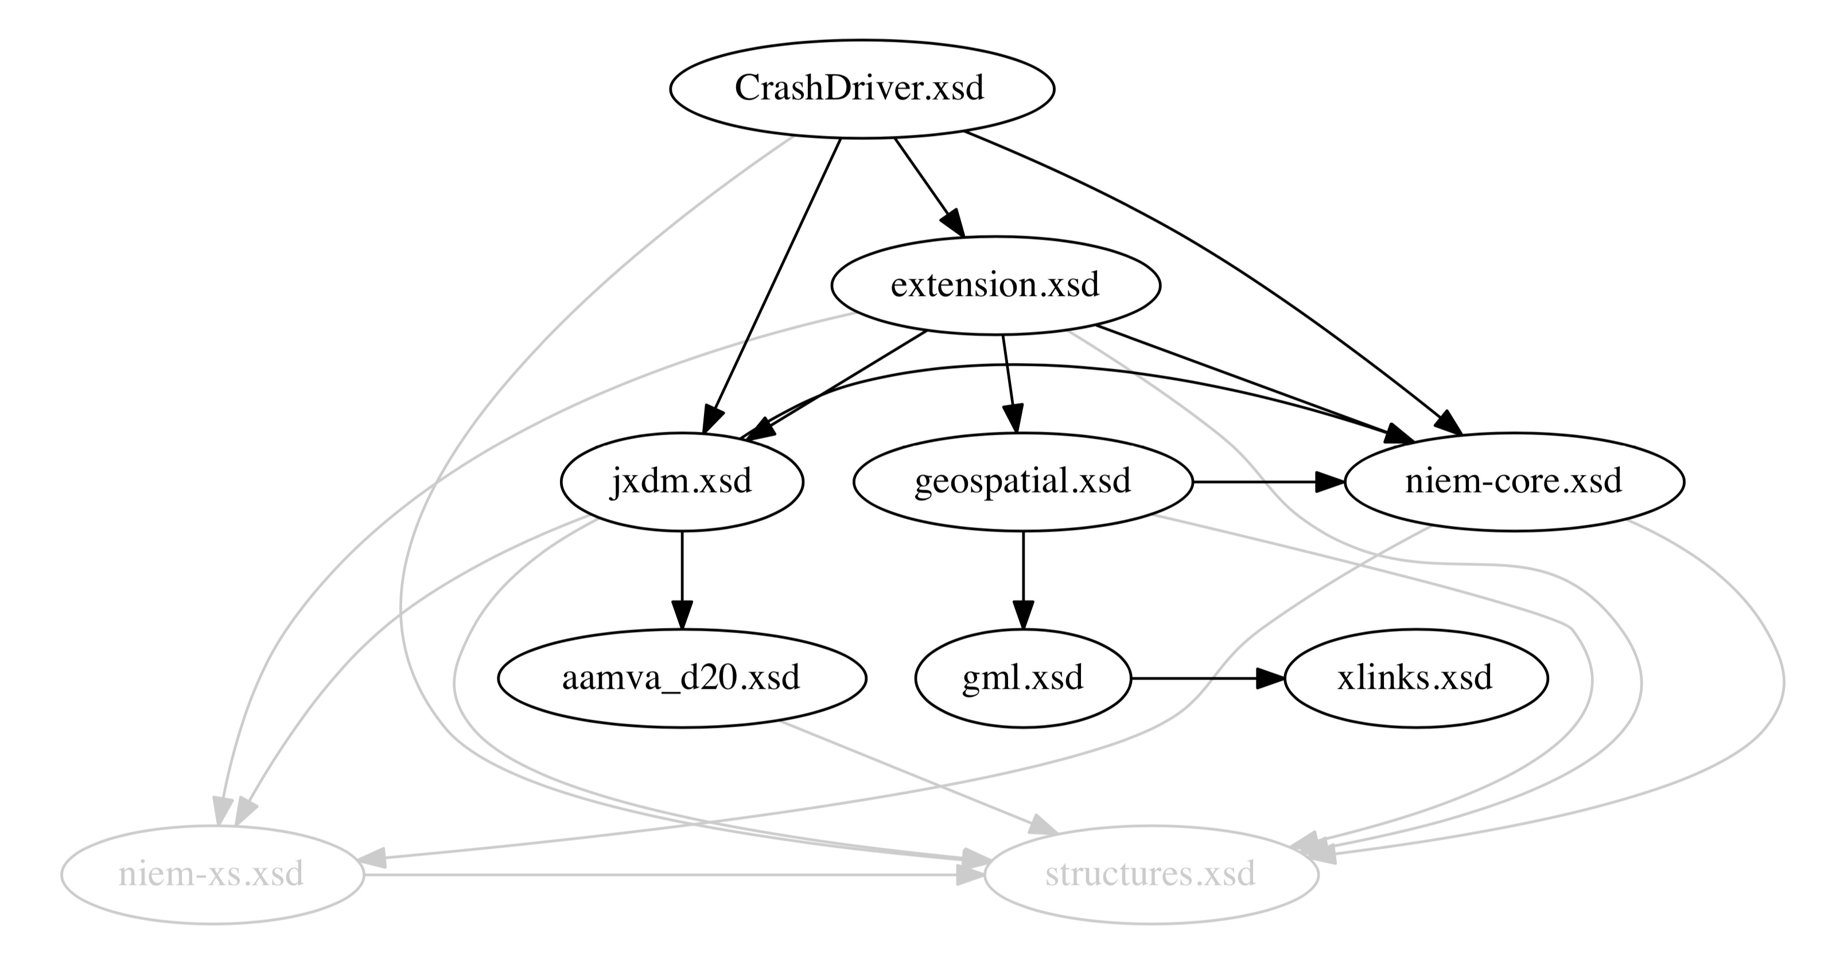
How Schemas Fit Together
External Standards

Slide 88
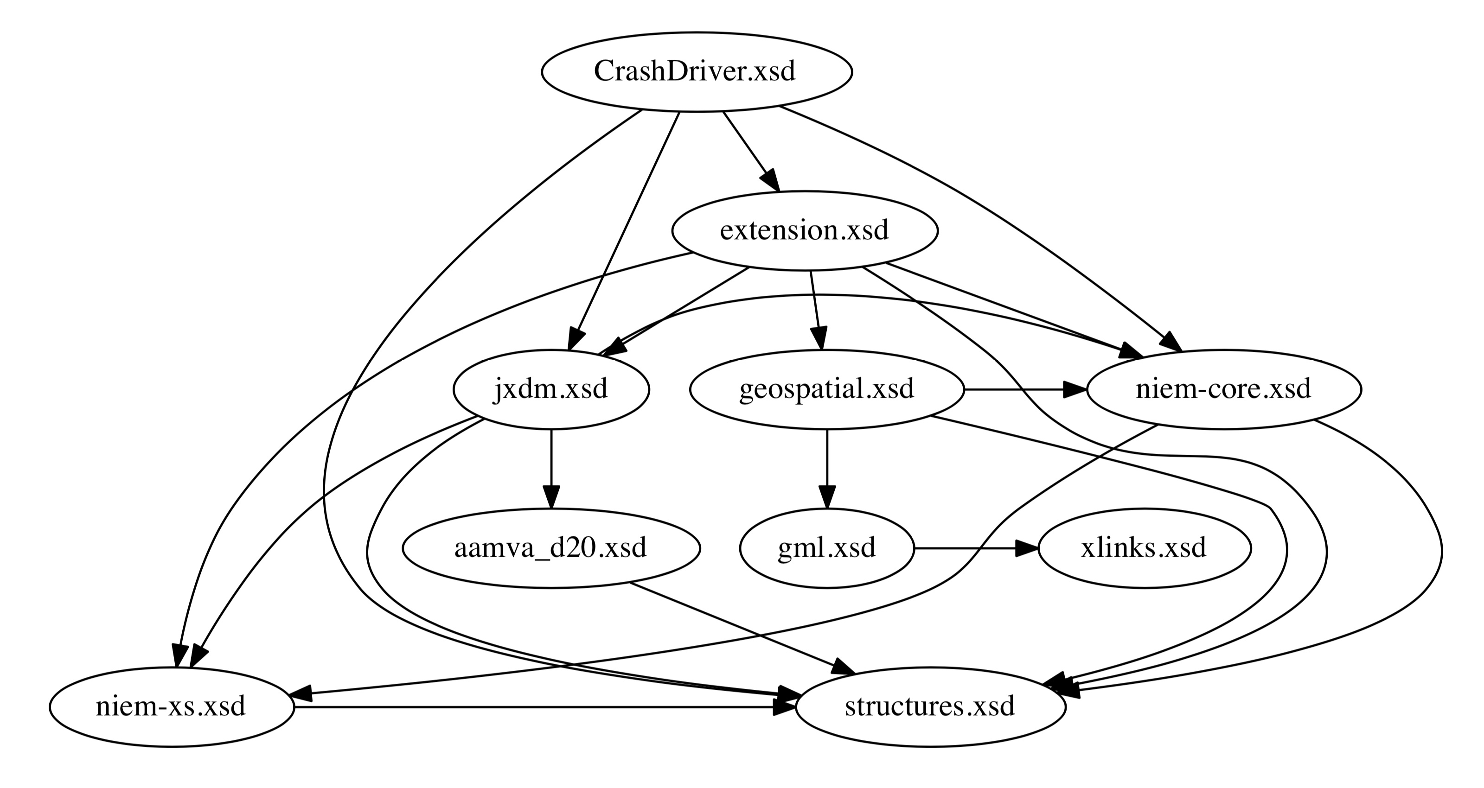
How Schemas Fit Together
Infrastructure

Slide 89
Schema Subsets
NIEM has over 11,000 elements
You don’t want them all
NIEM supports mini versions of NIEM
With the elements / types you want
Plus things needed to make the elements / types you want work
Use the SSGT for this!

Slide 90
Extension Schema(s)
Create new elements for your exchange
Emulate how NIEM does it
Utilize Augmentations to add your new objects to existing NIEM objects
Concrete extension is an alternative
Can have multiple extension schemas
Some folks put code tables into a separate extension schema

Slide 91
Exchange Schema
Entry point to the exchange
Defines the root element of the exchange
Some put the definition for the root element here
Some put that in the extension schema
Some lump exchange and extension together
An exchange with multiple messages can have multiple exchange schemas, one per
Can share a common extension
Or not

Slide 92
Schema Help
Use a good XML editor
Declare a conformance target
Just use the same one I am
Declare and import all schemas used
Watch out for schemas incorporated only via substitution groups
Group heads don’t know who the members are
Still need to declare and import those

Slide 93
Example Instances
Required
Validating against your schemas ensures your intent
Some XML editors can create them from schemas
But you’ll always need to tweak those
Other tools are out there…

Slide 94
Tips and Tricks
Christina’s oXygen Snippets
Use Schematron to check your work as you go
Tom’s BBEdit instance generation scripts
Tom’s Mapping Spreadsheet Linter

Slide 95
Other Artifacts
IEPD Catalog
Metadata about the IEPD
What file is what
Readme
Changelog
Conformance Assertion
Master Documentation

Slide 96
Master Documentation
Executive Summary…………………... | 1
<Name> Information Exchange……... | 2
Overview of the <Name> Exchange Exchange Partner Interaction
Business Models………………………. | 4
Business Rules and Requirements… | 7
Exchange Content Model…………….. | 7
Development Information……………. | 8
IEPD Definition Tools and Methodologies Testing and Conformance
Appendices………………………………… | 11
List of IEPD Artifacts IEPD Catalog
A NIEM IEPD master document should (at a minimum) describe the IEPD purpose, scope, business value, exchange information, senders/receivers, interactions, and references to other documentation.
Don’t paste schemas into them!

Slide 97
IEPD Assembly
IEPDs are just ZIP files full of artifacts
Can organize how you like
The IEPD Catalog is the guide to your organization
Generally, keep it simple
MEP Builder will help with this (coming soon)

Slide 98
Publishing
Existing repositories are out of date
IEPD Clearinghouse
Work With IEPDs
New repositories are coming
Restricted (coming soon)
Unrestricted (coming later)

Slide 99
Implementation
Remember that NIEM is just the payload
It’s just plain old XML
Well, okay, with referencing
Or it’s just plain JSON
Well, okay, with JSON-LD
Remember the scope of NIEM
Things outside the payload aren’t NIEM
You don’t have to do anything special for NIEM outside NIEM’s scope

Slide 100
Skill level to Implement NIEM
Developers with the skills to design and implement a data exchange can learn the NIEM approach in a matter of hours
Developer training is available
No-cost online courses are on the NIEM website
Plenty of example IEPDs to follow
Don’t start from scratch, leverage shared IEPDs
The NIEM technical specifications are complex, however
Most developers do not need to read them
Free tools can perform most of the conformance checking

Slide 101
Resources - Documentation
NIEM Releases
http://niem.github.io/niem-releases/
NIEM Specifications
http://niem.github.io/reference/specifications/
Materials from this course:
https://github.com/NIEM/NIEM-Training
These are internal work products

Slide 102
Resources - Tools
SSGT:
https://tools.niem.gov/niemtools/ssgt/index.iepd
Conformance Testing Assistant (ConTesA)
https://tools.niem.gov/contesa/
NDR Schematron
https://niem.github.io/reference/tools/oxygen/ndr/
MEP Builder (coming soon)

Slide 103
Resources - Tools
Wayfarer:
http://niem5.org
oXygen Snippets
https://niem.github.io/reference/tools/oxygen/snippets/
Mapping Spreadsheet Linter / Schema Generator (coming soon?)
Instance generation scripts (coming soon)

Slide 104
Resources - Repositories
IEPD Clearinghouse
https://bja.ojp.gov/program/it/policy-implementation/clearinghouse
Work with IEPDs
https://tools.niem.gov/niemtools/iepdt/index.iepd

Slide 105
Course Questions?
Should get a survey tomorrow
Be candid
Format? Live? Staged?
Length? Longer with more detail? Shorter with less?
Timing? Back-to-back-to-back? One per week for three weeks?
Exercises?

